Slide 1


Bicriteria Paths Problem Andrea ROSSOLINI
ALMA MATER STUDIORUM
UNIVERSITÀ DI BOLOGONA

Slide 2
Index
Introduction
Mathematical formulation of the problem
Mono-criteria algorithms
Bicriteria algorithms
Implementation choices

Slide 3
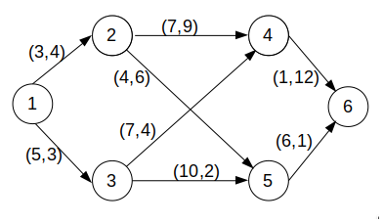

What does it mean «Bicriteria»?
Paths:
1 → 2 → 4 → 6
(11, 25)
1 → 2 → 5 → 6
(13, 11)
1 → 3 → 5 → 6
(21, 6)
1 → 3 → 4 → 6
(13, 18)

Slide 4

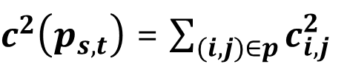
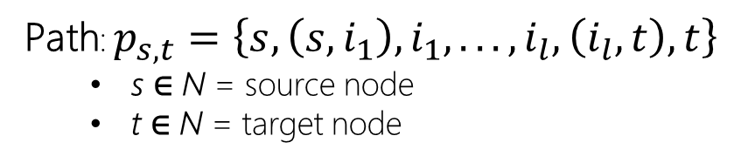
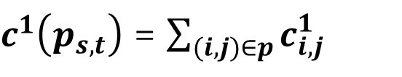
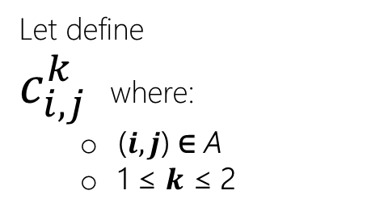

(short) Mathematical formulation
Graph: G(N, A) where:
N is a finite set of {0, 1, …, n} → nodes
A is a finite set where A ⊆ N × N → arcs
(i, j) single arc where i ∈ N ꓥ j ∈ N ꓥ i ≠ j
Let define
$c_{i, j}^{k}$ where:
($i, j$) ∈ A
1 ≤ $k$ ≤ 2
Path: $p_{s,t}=\left\{s,\left(s, i_{1}\right),i_{1}, . . . ,i_{l},\left(i_{l}, t\right), t\right\}$
s ∈ N = source node
t ∈ N = target node
$c^{1}\left(p_{s,t}\right)$ = $\sum_{(i,j)∈p}{c_{i,j}^{1}}$
Distance
Danger
$$(c^{1}\left(p_{s,t}\right),c^{2}(p_{s,t}))$$
$c^{2}\left(p_{s,t}\right)$ = $\sum_{(i,j)∈p}{c_{i,j}^{2}}$

Slide 5
Mono-criteria algorithms
Dijkstra one to all
Dijkstra one to one
Dijkstra list of candidate
A* algorithm

Slide 6
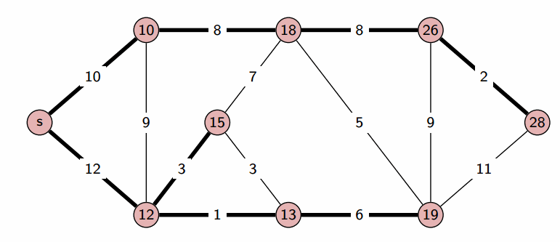

Dijkstra one to all
Dijkstra’s algorithm
Greedy algorithm
Work with non-negative weights
It implements a pryority queue
Allows to find the shortest path tree (the shortest path between the source and any other vertex)
IT DOESEN’T STOP UNTIL THE GRAPH IS TOTALLY EXPLORED
Complexity: O((|N| + |A|) ∙ log |N|)
When A>>N→(|A| log|N|)

Slide 7

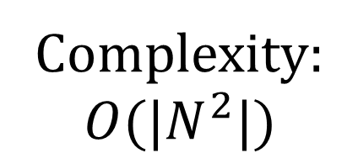
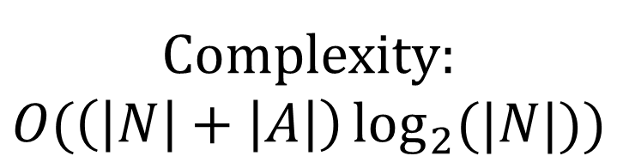
One to one
List of Candidates
It doesn’t implement a priority queue
It iterates all over the graph in search of the next node (the one with the value «distance» lower)
It implements a priority queue
At each iteration it updates the pryority queue with the nodes near the border
Complexity:
$$O(|N^{2}|)$$
Complexity:
$$O(\left(\left|N\right|+\left|A\right|\right)\log_{2}{(|N|)})$$

Slide 8
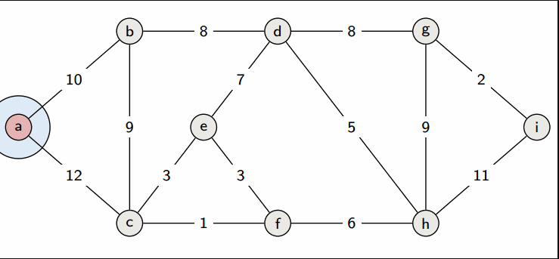


b
c
a
List of candidates
10
12

Slide 9
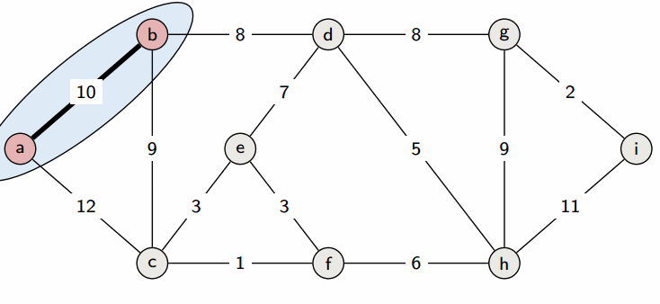
c
d
b
List of candidates
12
18

Slide 10
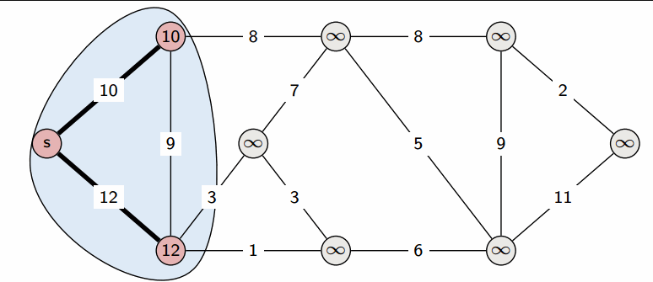
b
a
c
f
e
d
c
List of candidates
13
15
18

Slide 11
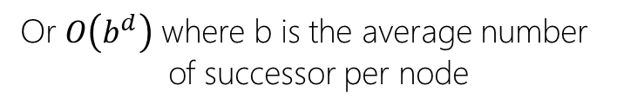

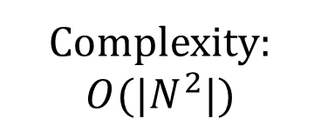

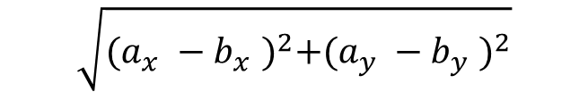
«A Star» algorithm
Extension of Dijkstra’s algorithm
It uses a priority queue
Complexity:
$$O(|N^{2}|)$$
Select nodes to minimize:
$$f\left(n\right)=g\left(n\right)+h(n)$$
Or $O\left(b^{d}\right)$ where b is the average number of successor per node
Anyway it depends by the heuristic function
Heuristic function
$n$: next path’s node
Euclidean distance
$$\sqrt{{(a_{x}^{}−b_{x}^{})}^{2}+{(a_{y}^{}−b_{y}^{})}^{2}}$$
Cost of the path from the beginning

Slide 12
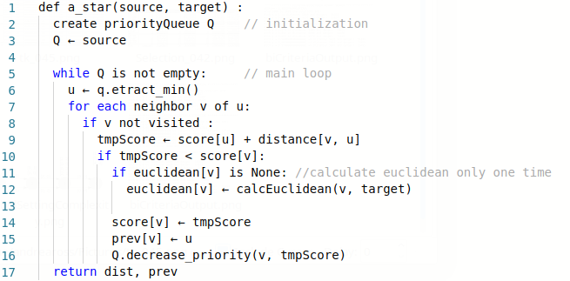
A* Pseudocode

Slide 13
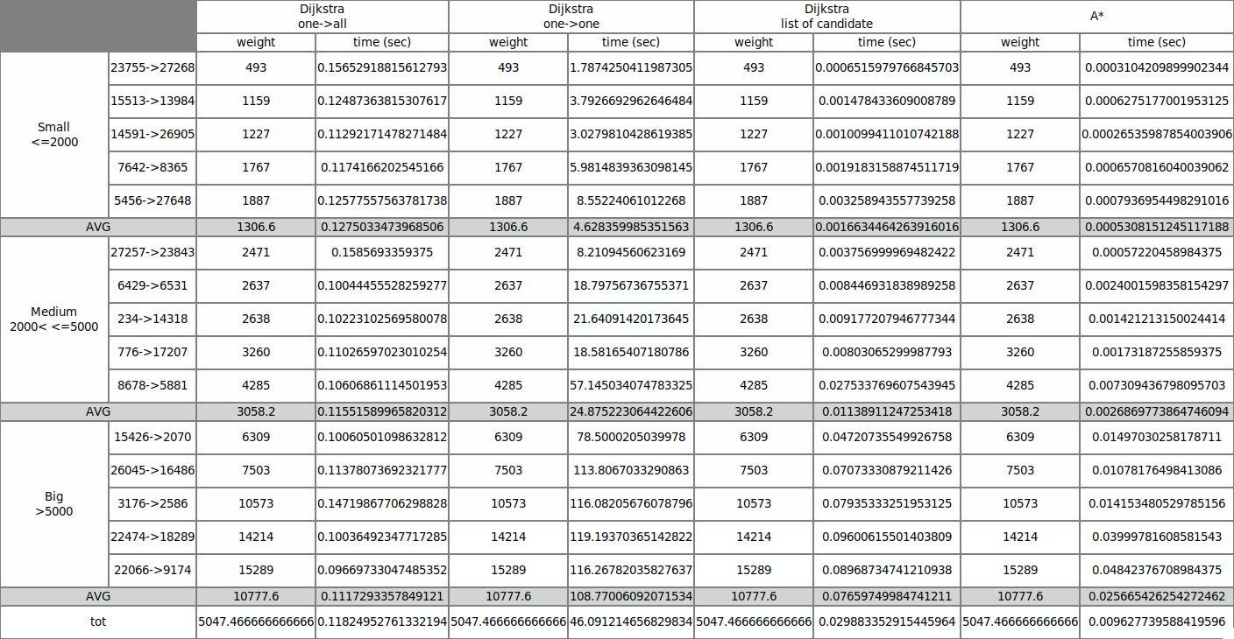
Graph generated with tkinter library

Slide 14
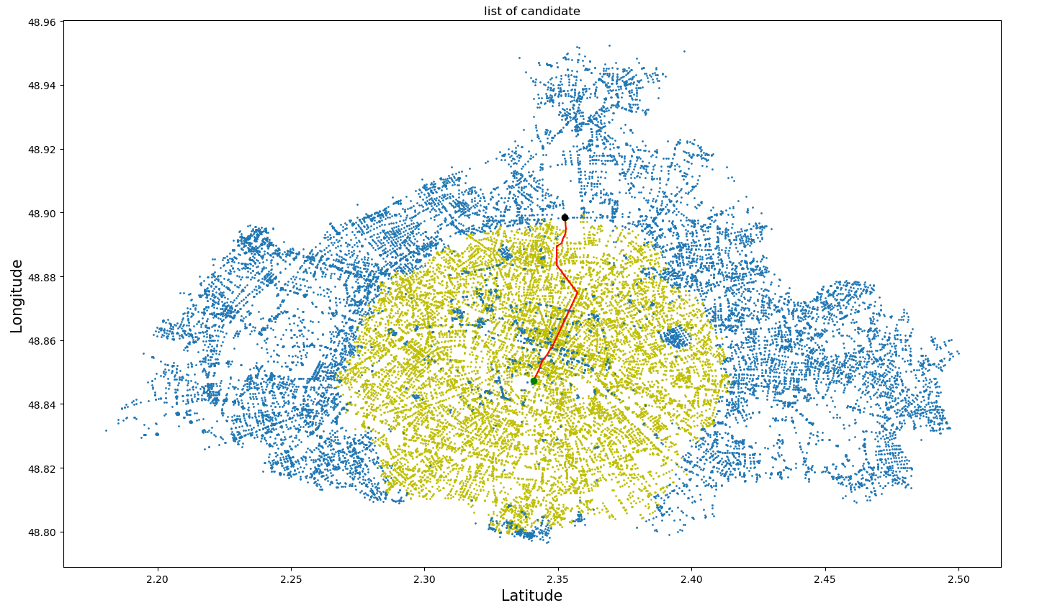
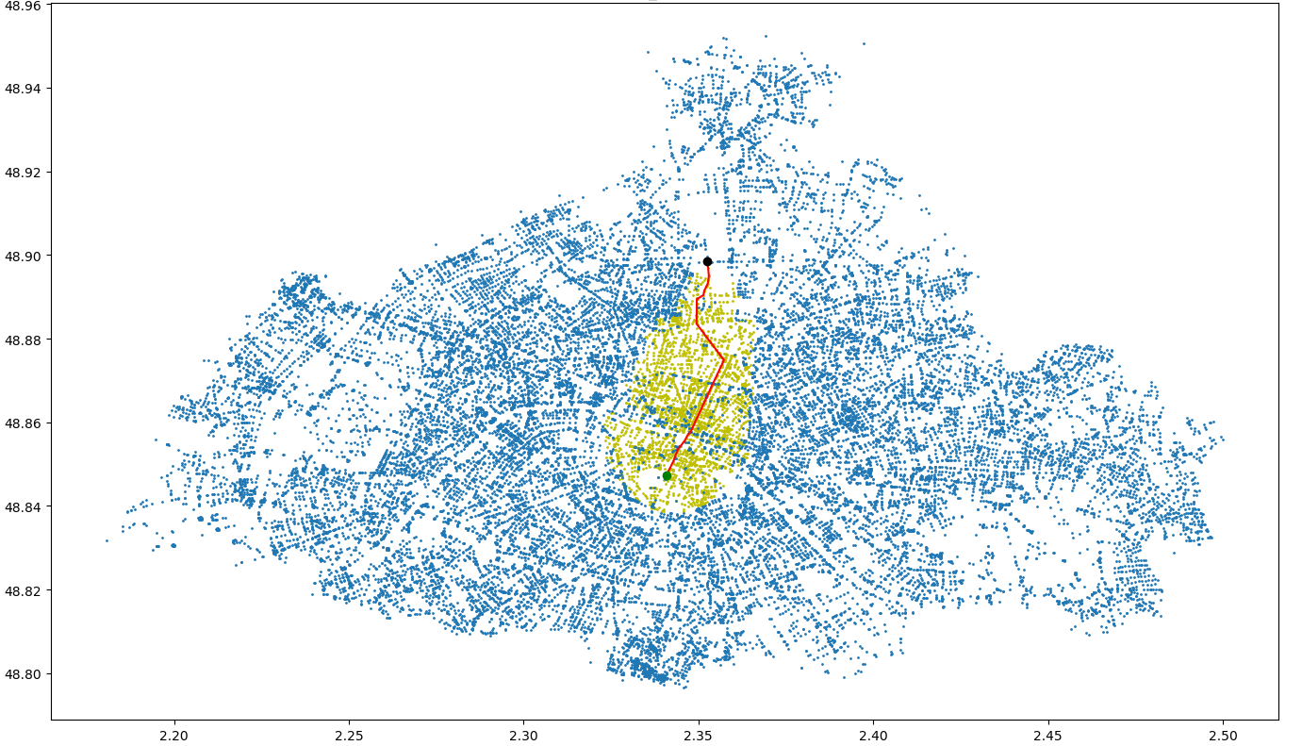
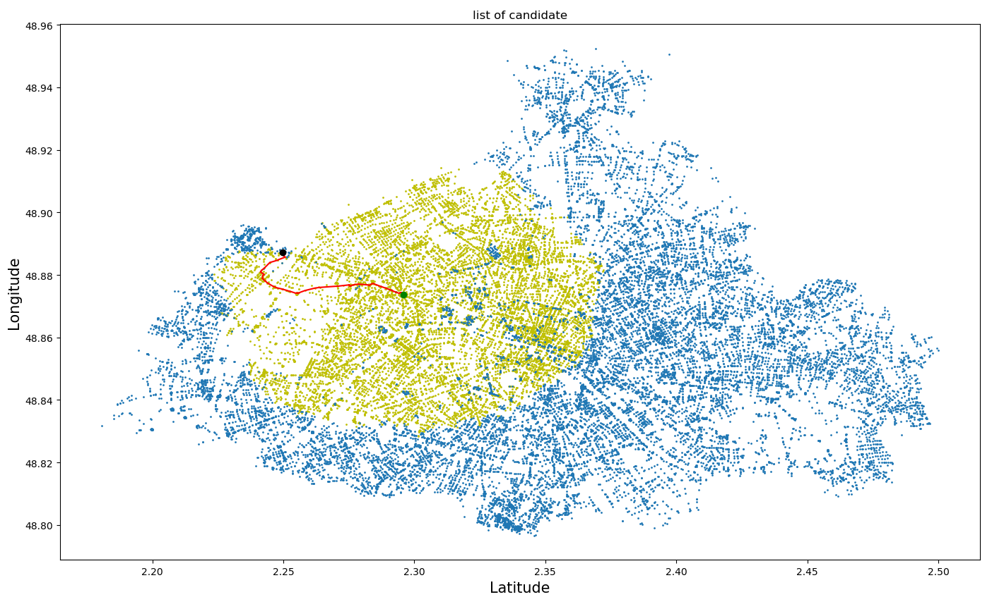
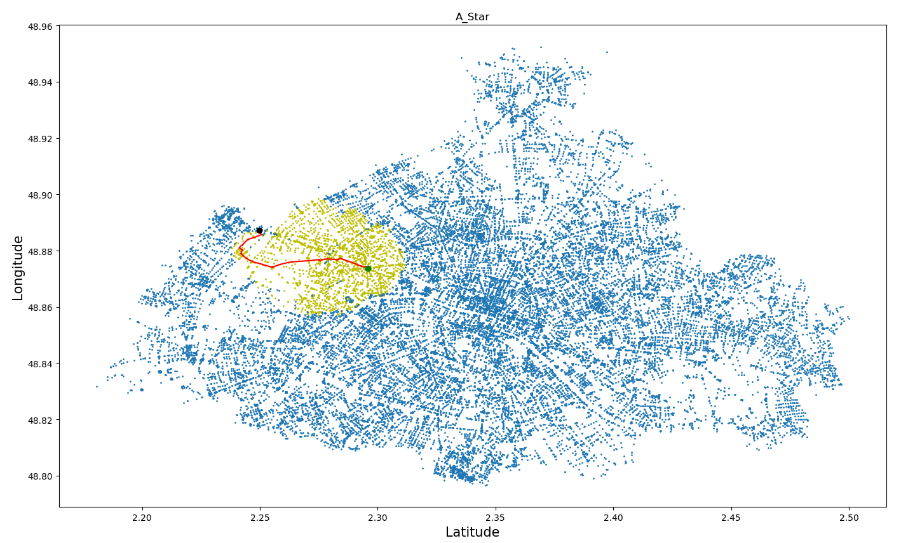
List of candidates
A Star
Source: 2070 → Target: 15426
Source: 2000 → Target: 2689

Slide 15
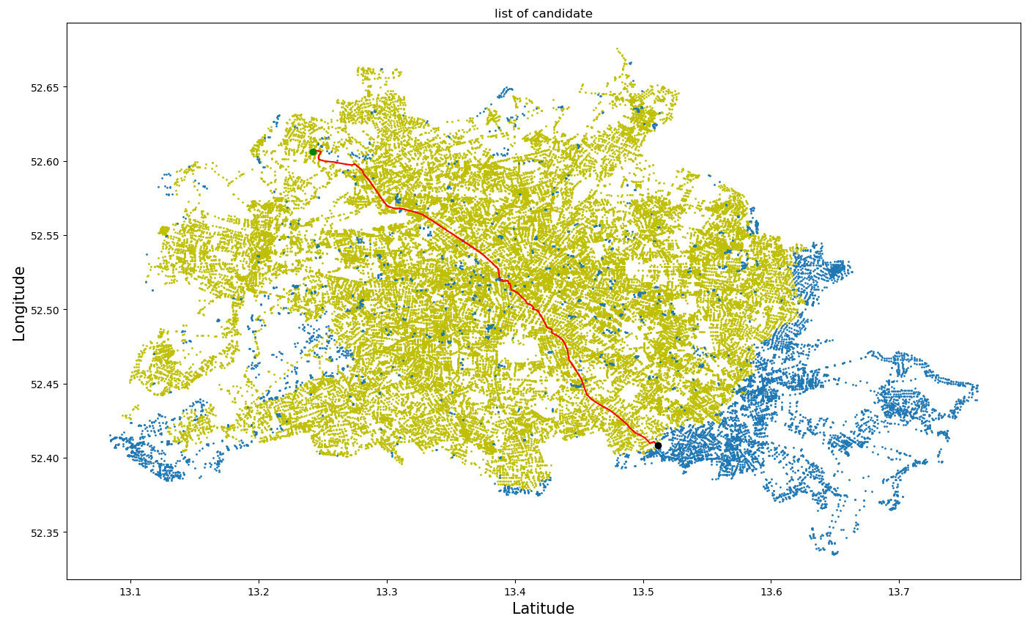
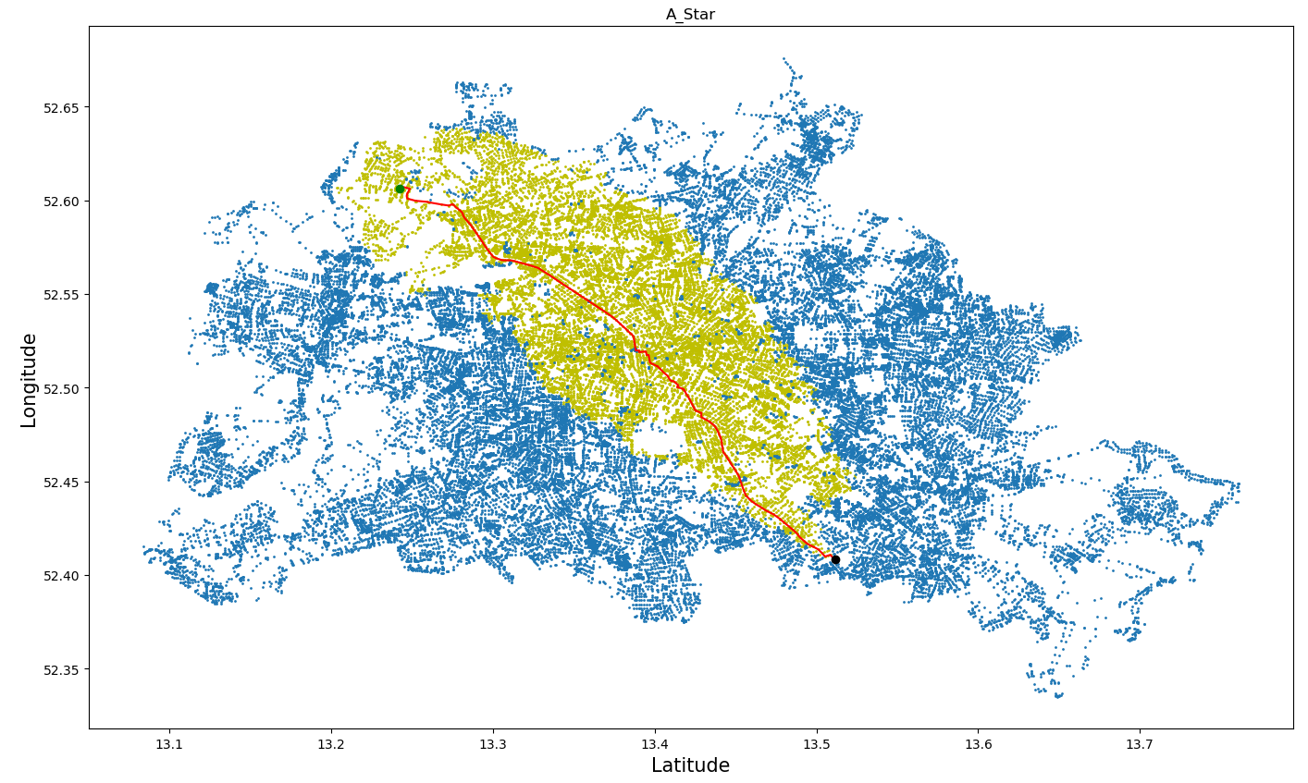
List of candidates
A Star
Source: 1000 → Target: 1510
Map: Berlin

Slide 16
Bicriteria algorithms
Dijkstra Bicriteria
Label-setting algorithm
Lsa with lower bound improvement

Slide 17
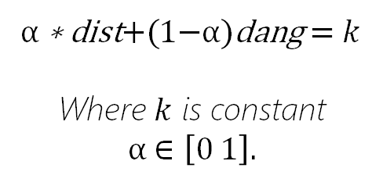
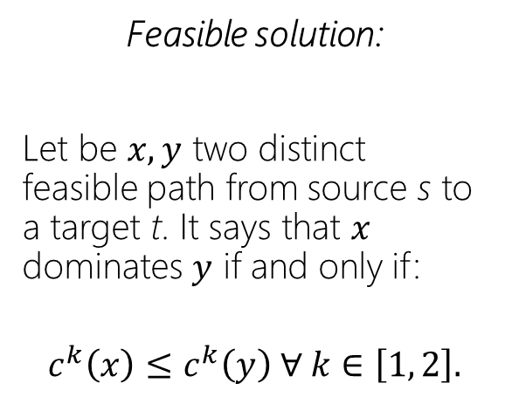
Useful definitons
Feasible solution:
Let be $x, y$ two distinct feasible path from source s to a target t. It says that $x$ dominates $y$ if and only if:
$$c^{k}\left(x\right)≤c^{k}\left(y\right) ∀ k∈\left[1, 2\right].$$
Convex hull:
The convex hull of a set X of feasible solution is the smallest convex set that contains X.
Pareto front
Defined by this equation:
A set of optimal solutions.
A set of not-dominated points (no other point with better values for each point's critera).
A point can be part of Pareto front whitout dominate any other point.
α ∗ dist+(1−α)dang = $k$
Where $k$ is constant
α $∈\left[0 1\right].$

Slide 18
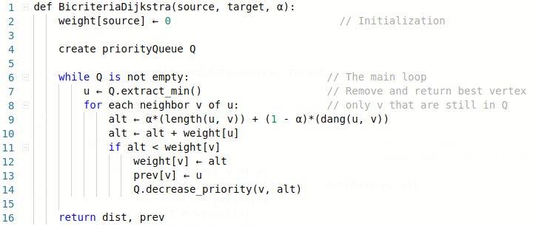

Dijkstra bicirteria
Graph with double weights:
$$G=(N, V, dist, dang)$$
Reducible to:
$$G=(N, V,α∙dist +\left(1−α\right)dang)$$

Slide 19
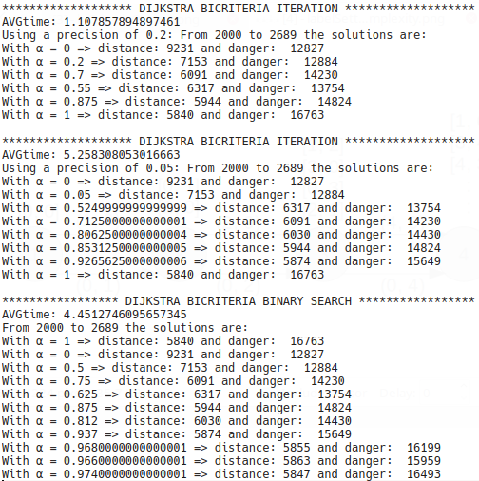
Dijkstra Iteration
vs
Dijkstra Binary search

Slide 20
LabelSetting algorithm
$$(distance, danger, owner,predecessor,ownerIndex, predIndex)$$
Distance from the source
Label’s index inside predecessor’s list
Danger from the source
Label’s index inside the owner’s list
Node that own the label
Owner’s parent node

Slide 21
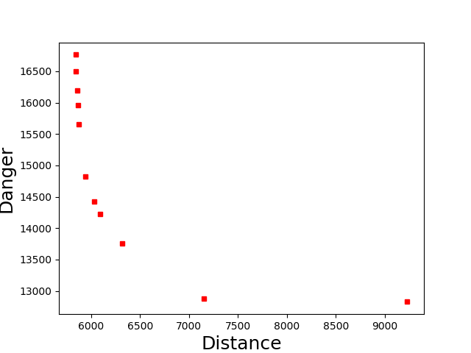
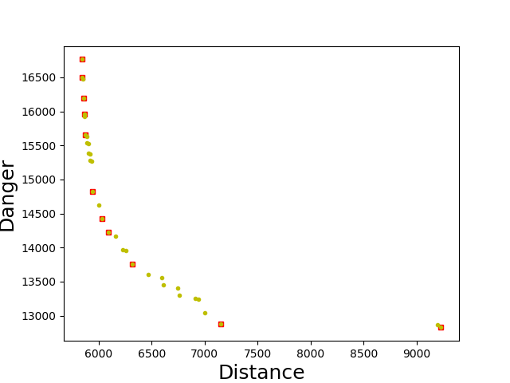
Dijkstra bicriteria
vs
Label-setting algorithm
= Convex hull
= Pareto front

Slide 22
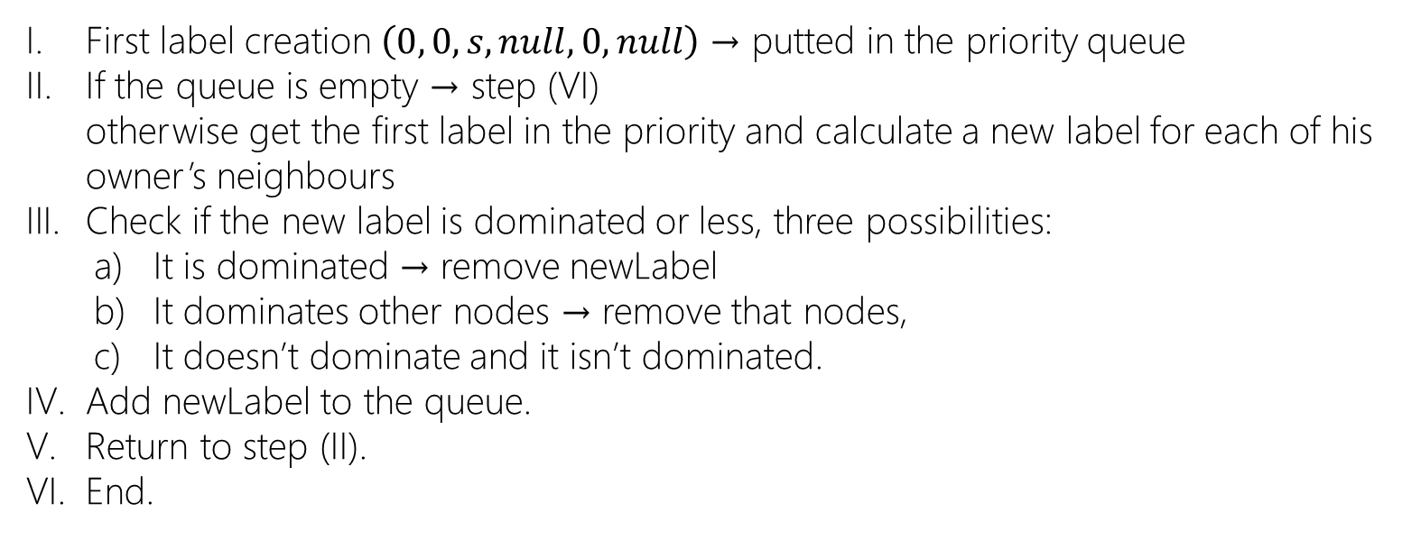
Label-setting algorithm
Implementation
First label creation $\left(0, 0, s, null, 0, null\right)$→ putted in the priority queue
If the queue is empty → step (VI) otherwise get the first label in the priority and calculate a new label for each of his owner’s neighbours
Check if the new label is dominated or less, three possibilities:
It is dominated → remove newLabel
It dominates other nodes → remove that nodes,
It doesn’t dominate and it isn’t dominated.
Add newLabel to the queue.
Return to step (II).
End.

Slide 23
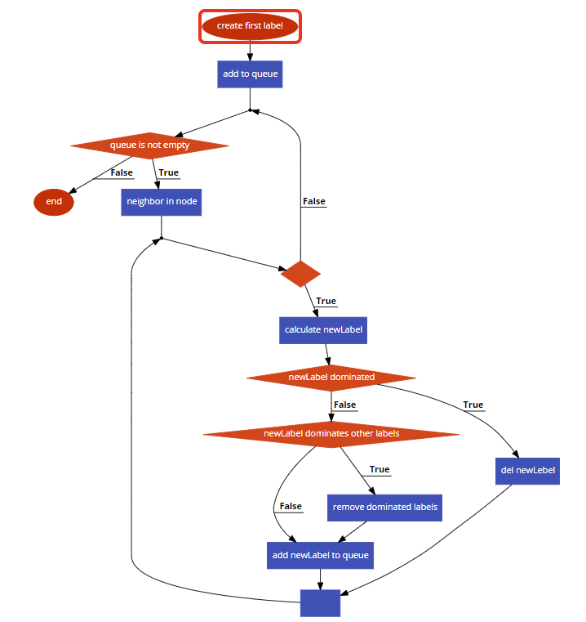
Explanation of the algorithm with a flow chart

Slide 24
Label-setting algorithm with lower bound improvement
It’s an extension of the label-setting algorithm.
Consists in calling Dijkstra bicriteria algoritm in with α = 0 and α = 1, finding the shortest and the safest path, before run the label-setting algorithm.
Is possible to know the best values of some visited nodes and in this way can calculate before if a new label is dominated or less

Slide 25
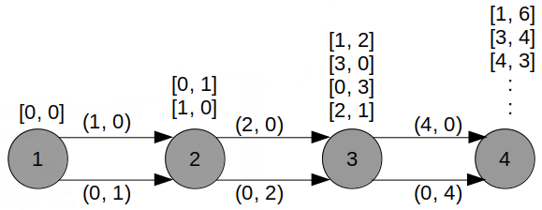
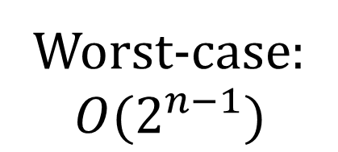
Time complexity of label-setting algorithm
Worst-case:
$$O(2^{n−1})$$

Slide 26
Some results

Slide 27
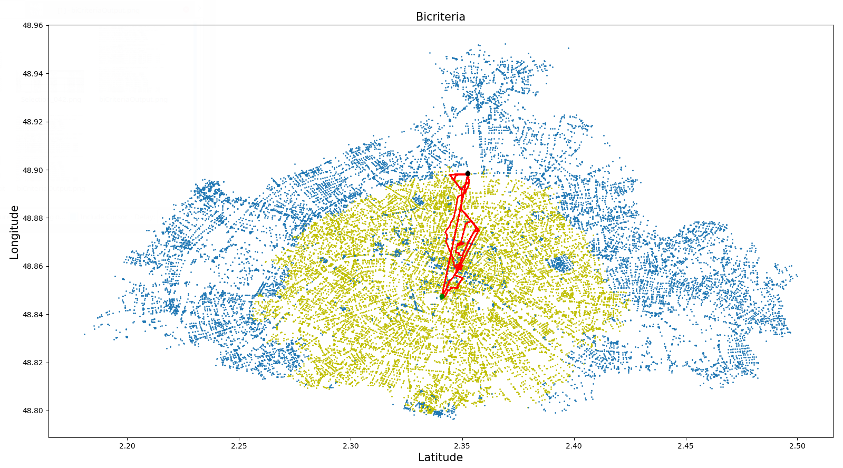
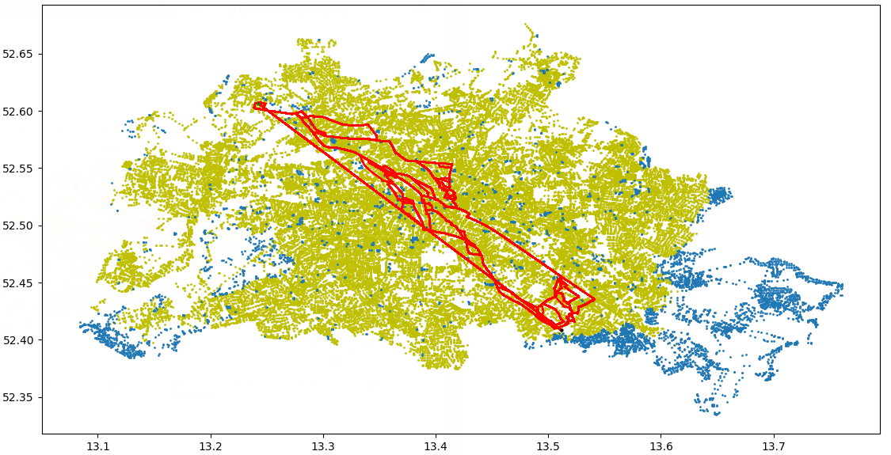
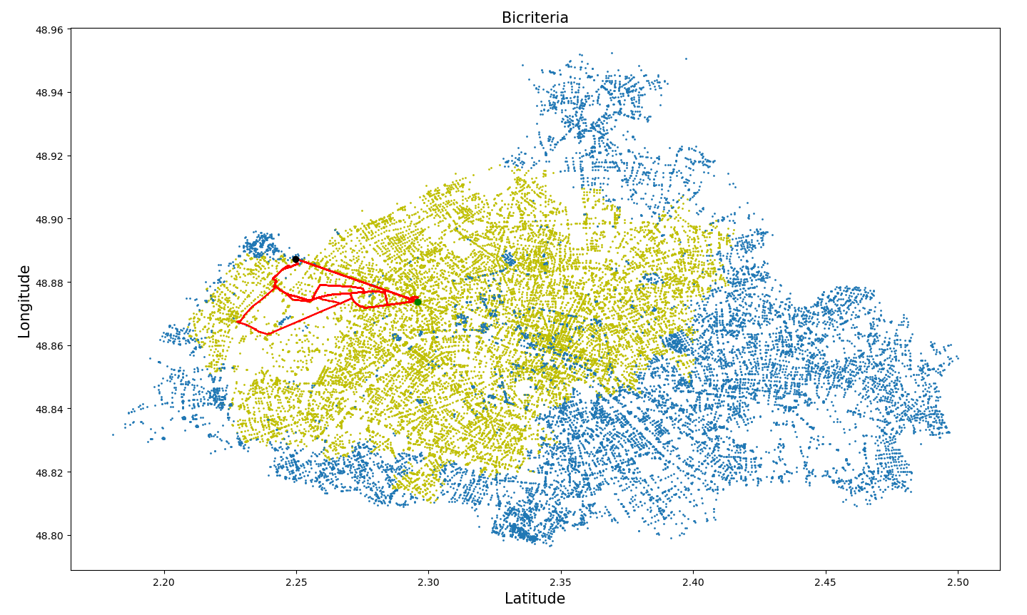
Source: 2070 → Target: 15426
Source: 2000 → Target: 2689
Source: 1000 → Target: 1510 | Map: Berlin

Slide 28


Implemetation choices
Graph’s nodes as OBJECTS
Binary queue instead of a Fibonacci heap

